Slide 1
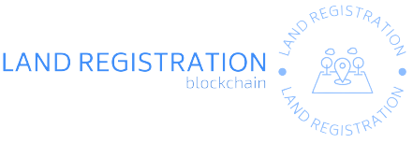
LAND REGISTRATION PLATFORM BASED ON BLOCKCHAIN
~Jatin Chawla [4020766]

Slide 2
INTRODUCTION
Today, blockchain is what the iPhone was in 2007. Revolutionary and disrupting, it can soon become a common part of day-to-day life with transparency in business operations. This is an application of the Land Registration System.
Land registry in India as well as in many parts of the world is a very slow and inconvenient process.
Current land registration & verification systems include an increasing number of fraud cases and loss of paperwork and court cases due to thousands of land records to maintain.
Using the system, validation of the lands is also possible as immutable transactions are being stored in the public ledger.
So the Land Registration system using blockchain is a distributed system that will store all the transactions made during the process of land buying.
This will also be helpful for buyers, sellers and government registrars to transfer the land ownership from seller to new buyer as well as it will accelerate the process of registration.

Slide 3
Objectives
In the proposed land registration system, all phases from buying to selling of a land take place through the blockchain environment through their own smart devices, thereby overcoming the need to move around.
Also, there is a need to adopt the emerging technologies to offer a wide set of services to the users online rather than offline approaches.
If the blockchain environment is used to serve the aforementioned purpose, then every entity across the network can access the ledger data and hence it gets easy to track the malicious nodes .
Through Blockchain, it is possible to keep track of how property changes hand to hand. For buyers, sellers and Government registrars, it is easier to transfer the land ownership from a seller to a new buyer without any intermediaries.
It provides immutability, auditability and traceability features which attracts the people around the globe to implement its decentralization feature in the land registry process.

Slide 4
PURPOSE AND SCOPE
Purpose : The intuition behind building this was to make the process of land registration resilient and decrease the cases of fraud in the process.
Scope : The main purpose of this project is by using the system, validation of the lands is also possible as immutable transactions are being stored in the public ledger.
So the Land Registration system using blockchain is a distributed system that will store all the transactions made during the process of land buying.
Also this project has an easy user interface so that the user can use this web application easily

Slide 5
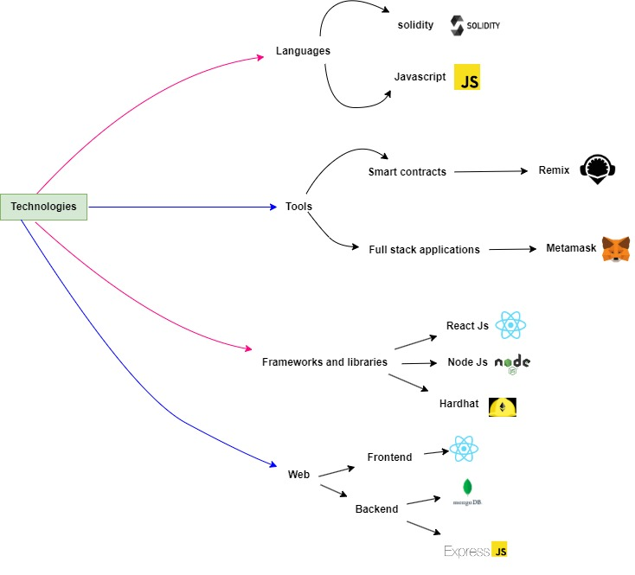

Slide 6
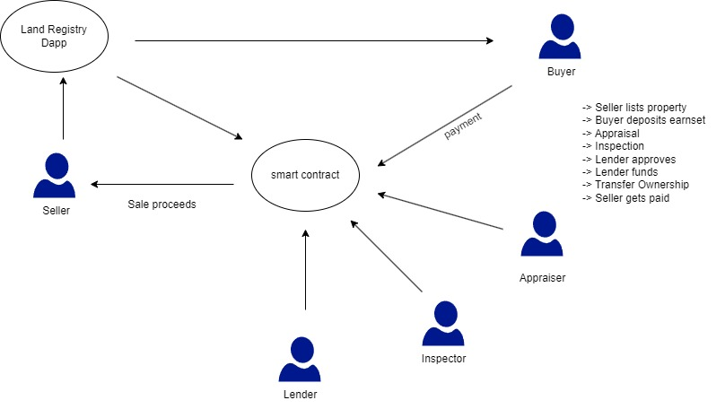

Slide 7
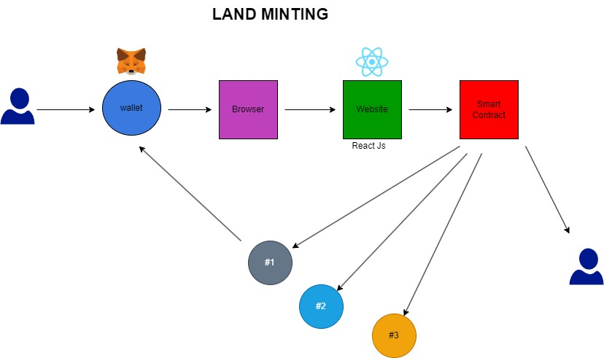

Slide 8
CONCLUSION AND FUTURE SCOPE
This work dealt with the basic smart contract creation and deployment of the Land Registration process. All the functionalities thought necessary in the land registration process have been implemented and tested on the Remix IDE and Chai js library.
There is a significant scope to develop this project further by designing a suitable web application and integrating it with the smart contract and Ethereum Meta Mask application to make it more user friendly and easy to use.

Slide 9
CONCLUSION AND FUTURE SCOPE
The Land Registration process can be further enhanced by automating the Land Verification Process and Land Updating Process.
Further versions could be developed to include Land Splitting Case. Extra functionalities like Land gift and Land Inheritance can be introduced in further versions.
Also, this system mainly depends on the citizenship data that is maintained by the government.

Slide 10
THANK YOU

